Slide 1
AINT351: Machine Learning Lecture 8 Information theory

Slide 2
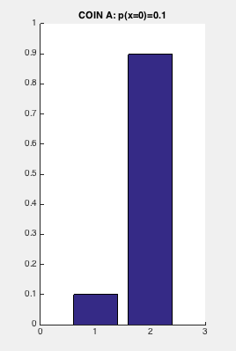
Information Theory
The probability P(X) encodes uncertainty about the random variable X
Imaging we have an LED that is used to communicate with us
It is very often switched on
It does not change very often
Its outcome is therefore not very informative

Slide 3
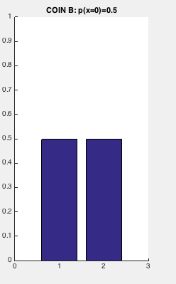
Information Theory
Now consider an LED which the outcomes are randomly spread between the two possibilities
On average it is
50% of the time on
50% of the time off
Intuitively this suggests it can
transmit more information

Slide 4
Entropy
We can quantity the information represented in such a random variable
This is the entropy of the variable X which is the average amount of information required to encode X
When the logarithm is base 2, then H(x) is the information in bits

Slide 5
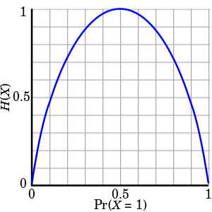
Maximum entropy of 1 binary variable
In the case of the single LED P(x) it is binary with two outcomes
But in general if could have some arbitrary distribution of values
We note that H(x) is maximum when P(x=0) =0.5 and P(x-1) = 0.5
This the when the distribution has maximum entropy

Slide 6

Conditional entropy
The conditional entropy is given by
From the relation
Therefore

Slide 7
Mutual information
The mutual information is given by
It indicates how much knowledge if Y affects our belief in X
If Y has no effect and is independent of X then the mutual information is zero

Slide 8
AINT351: Machine Learning Lecture 8 Multidimensional Gaussian classifier

Slide 9
Naïve Bayes versus full Gaussian classifier
The probability of a data point (how probable is x_{i} under source c) is given by
Full Gaussian classification uses a full covariance matrix
For example
Can represent any Gaussian distributions
Difficult to estimate parameters

Slide 10
Naïve Bayes versus full Gaussian classifier
The probability of a data point (how probable is x_{i} under source c) is given by
Naïve Bayes only estimates and uses marginal Gaussian parameters
Only has non-zero values in the covariance matrix along its leading diagonal. E.g.
Assumes variables are independent - zero covariance
Can only represent distributions aligned with coordinate system
Easy to estimate parameters

Slide 11
Naïve Bayes versus full Gaussian classifier
In both cases the probability of a data point (how probable is x_{i} under source c) is given by
Using Bayes rule the probability data point x_{i} came from class c is given by
Choose most probable class given observation
We can also bias towards once class if we wish
E.g. can reduce false alarms at the expense of fewer hits

Slide 12
AINT351: Machine Learning Lecture 8 Discriminant classifiers

Slide 13
Limitations of generative models
Bayes’ decision rule minimizes average probability of error
Can train generative models by directly estimating parameters
So what needs improving?
Bayes classifier is the minimum error classifier only if out model of the data is appropriate
In particular if the form of the class-conditional distribution is correct

Slide 14
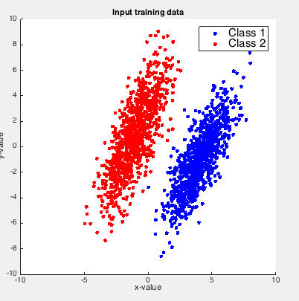
Discriminative models
Generate model classification requires the class-posterior P ( ω j|x )
Discriminative models use parameters more closely related to classification process
They are not dependent on generative process being correct
Don’t model the data just try to find decision boundary
Example is the perceptron
Neural network techniques
E.g. discriminate two sets of labeled data
Where is the decision boundary?

Slide 15
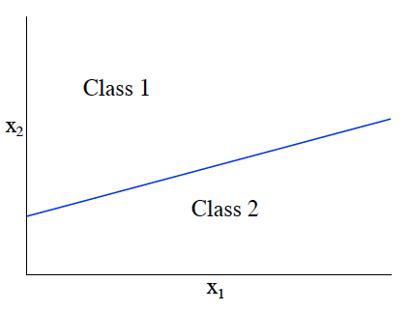
Linear decision boundaries
Decision boundaries partition the input-space into discrete regions
Each region is associated with a class label
In 2-D a linear decision boundary is a line, in 3-D a plane, in n-D a hyper-plane
Consider binary linear decision boundary:
W is a weight vector and b is a constant term
Using this boundary we can classify a datapoint
if g(x) > 0 then class 1
if g(x) < 0 then class 2

Slide 16
Linear decision boundaries
We can write the decision boundary in augmented form so that
Becomes

Slide 17
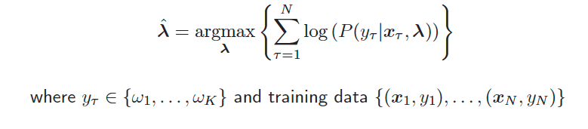
Discriminative model training
Before used maximum likelihood to find parameters generating the data
Similarly can maximize posterior of the correct class
This uses all training examples to derive boundary parameters
class
data

Slide 18
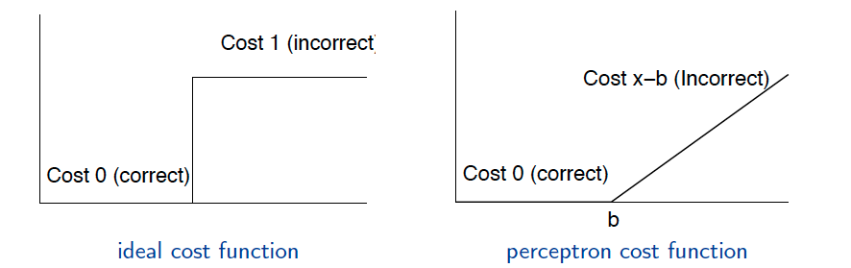
Cost functions
Need to specify what needs to be optimized to find the decision boundary
This is termed the cost function
Ideally we would like to minimize the error rate
This gives a step cost function
But need gradient descent for training
Differentiating step function results in delta function - not helpful!
Better to use differentiable function
Perceptron uses distance of incorrect observations from boundary

Slide 19
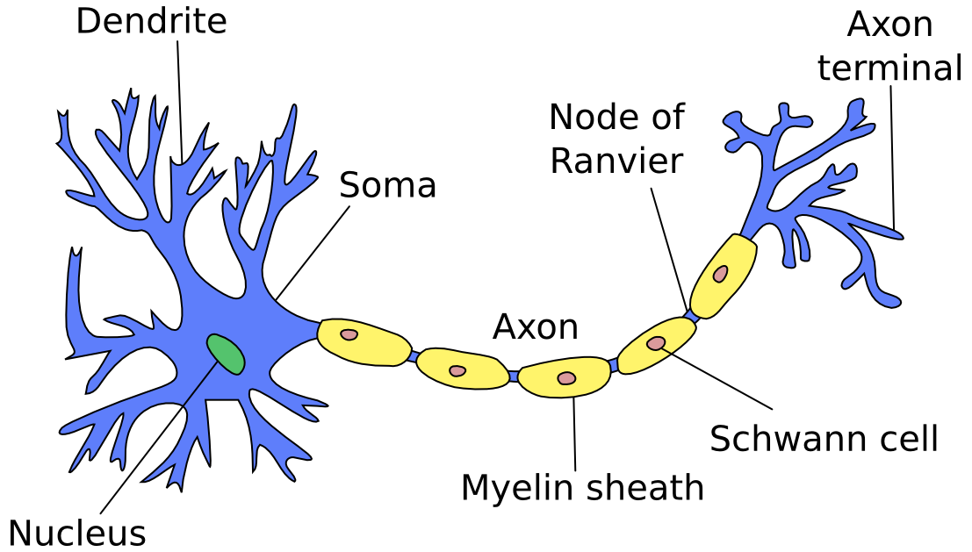
The perceptron
First neural network learning model in the 1960’s
Learning means changing the weights (“synapses”) between the neurons
Relationship between input and output
is important in computational neuroscience
Simple but limited capabilities (single layer models)
Basic concepts are useful for multi-layer models

Slide 20
Perceptron: A threshold logic unit
x₁
w₁
x₂
w₂
x_{n}
w_{n}
Learn weights such that an objective function is maximized
What learning algorithm should we use?
Notes:
What parameters and objective function

Slide 21
Perceptron learning rule
Create a perceptron node with n inputs
Iteratively apply a pattern from the training set
Calculate output
Apply the perceptron rule to update weights
Each iteration through the training set is an epoch
Continue training until total training set error ceases to improve
x₁
w₁
x₂
w₂
x_{n}
w_{n}

Slide 22
Perceptron learning rule
Compute perceptron output z (either a 1 or a 0)
Weight update given by
Δw_{i} = c(t – z) x_{i}
Where w_{i} is the weight from input i to perceptron node,
c is the learning rate,
t_{j} is the target for the current instance,
z is the current output,
x_{i} is i^{th} input
Notes:
Author uses y-t and thus negates the delta w

Slide 23
Perceptron learning rule
The weight update given by
Δw_{i} = c(t – z) x_{i}
Represents the least perturbation principle
Only change weights if there is an error

Slide 24
Comments on the perceptron algorithm
If the data is linearly separable then:
A linear decision boundary will correctly classifies all points
Algorithm will stop where there are no incorrectly classified training data points
The algorithm therefore guaranteed to converge to a solution
Two forms of update are generally adopted
batch update:
All the data is presented for each iteration
Weights only updated after all data seen
Sequential update:
Data is presented one sample at a time
Weights updated after each sample

Slide 25
Acknowledgements
Mark Gales

